Slide 1
Celebrate your Assessment

Slide 2
SAFAL
Structured Assessment for Analyzing Learning
Orientation for Teachers

Slide 3
AGENDA FOR THE MEETING
What is SAFAL.
Why is SAFAL.
01
02
Role of Teachers
Benefits of SAFAL
03
04

Slide 4
Relevant sections from National Education Policy 2020 pertaining to assessments at key stages:
To track progress throughout the school years, and not just at the end of Grades 10 and 12 - for the benefit of students, parents, teachers, principals, and the entire schooling system in planning improvements to schools and teaching-learning processes - all students will take school examinations in Grades 3, 5, and 8 which will be conducted by the appropriate authority.
These examinations would test achievement of basic learning outcomes, through assessment of core concepts and knowledge from the national and local curricula, along with relevant higher-order skills and application of knowledge in real-life situations, rather than rote memorization

Slide 5
Why SAFAL
Measure effectiveness of Learning system
Assess School level performance on key competencies and proficiency levels
The assessment of core competencies
Systematic monitoring and reporting of learning levels
Monitor the progress
Develop formal protocol and collect valid and reliable data to chart performance on competencies
Assist schools by providing a reliable and comparable ‘absolute’ measure of learning for parents, schools and state officials to assess school performance on core concepts

Slide 6
FOR WHOM?

Slide 7
Cognitive development of an individual
Age
1-3
Class 3
Class 5
Class 8
Class 10 &12
All Major Development
LSRW
Preparation for Secondary
Bargaining power of suppliers
Certification
Cognitive
Social relation
Psychomotor
basic literacy, numeracy, and other foundational skills.
Preparatory stage for Secondary Education
Divergent Thinking
Risk Taking
Innovative Idea
Exams provide student level performance data on key academic subjects, and is used to rank individual students on their performance

Slide 8
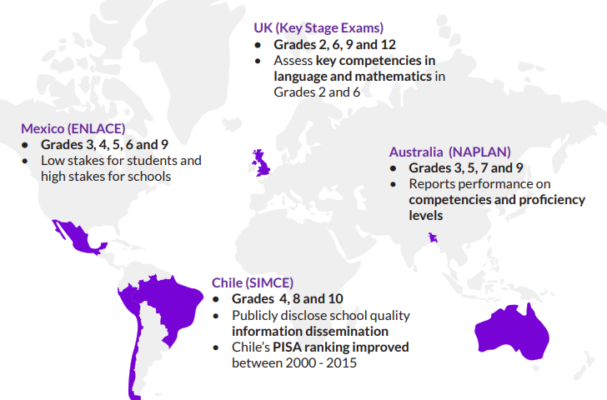
SIMILAR TYPES OF TESTS ALL OVER THE WORLD

Slide 9
Features of SAFAL ASSESSMENT
1
Core competency
Test Core concepts
Move away from rote Learning
Develop futuristic school
Shift from rote learning
2
COMPETENCY-BASED LEARNING
Aware about learning outcomes and develop re;ated cpmpetencies
Expected learning outcomes
Know the level of learning
SAFAL
3
Allowing students to demonstrate understanding and mastery of knowledge and skills they are expected to learn as they progress through the curriculum
Shift from traditional teaching system
Report to school, students and parents
Diagnostic reporting
4
Reports proportion of students at each proficiency level across grade level competencies and provide detailed diagnostic feedback to identify learning gaps.
Test core concepts

Slide 10
Your
School
What are the benefits
1. System-level assessments or evaluations for schools, regions, or national education system
SAFAL
2. To know about the real performance and Corrective measures
3. Preparation for PISA Participation
4. To Know where we are?

Slide 11
HOW CAN SCHOLS USE SAFAL?
1
2
The assessment will provide diagnostic information to schools on core competencies.
To identify areas of focus and guide schools towards improving their learning levels.
3
4
5
To know how much we are successful in learning outcomes
School performance on predetermined competencies and proficiency levels, can be used by school systems, school managements, and parents to improve learning outcomes
Compare our performance with national level performance
Defining
Executing
Attaining
Defining and setting learning outcomes.
How learning outcomes are implementing through teaching learning strategies
How they are attaining

Slide 12
SIMPERING ASSESSMENT AND EVALUATION
WHY SIMPERING IS OUR PARTNER IN SAFAL
Highlight 02
2
2012 onwards providing assessment tools and training to various schools of India
Highlight 01
2018 onwards conducting similar type of Assessment as NLBA
1
4
Highlight 04
We are the one among 500 schools selected for this opportunity
Highlight 03
3
Largest Network of experienced Teachers

Slide 13
Systematic shift from Online to Offline Assessment
Setting chapter wise competency Assessment Tools
1
STRATEGIES WILL BE USED
2
What strategies will be used to implement SAFAL preparatory examination
Strategies
4
Systematic Implementation of various pattern of questions to students
Chapter wise Offline/Online Assessment
3

Slide 14
BENCHMARKING METHODOLOGY
Identifying various types of questions
Identifying learning outcomes
Conducting SAFAL Preparatory Examination
Corrective measures in teaching and assessing
Activity oriented teaching
Preparing students asper schedule
Reviewing Performance
CBSE SAFAL EXAMINATION
Measure own performance
BENCHMARKING PHASE
POST-BENCHMARKING PHASE

Slide 15
What Simpering Offers
YES
NO
01
Schedule of examination
02
Syllabus Breakup
03
Question papers
04
Online Correction
SIMPERING ASSESSMENT AND EVALUATION
05
Offline correction
06
Model question
07
Report

Slide 16
For more details
www.ssaerc.com

